Slide 1
Short Story Generation for an Image Using the Encoder-Decoder Structure
Kushangi Sharma -211IT036
Kartik Rodagi- 211IT029

Slide 2
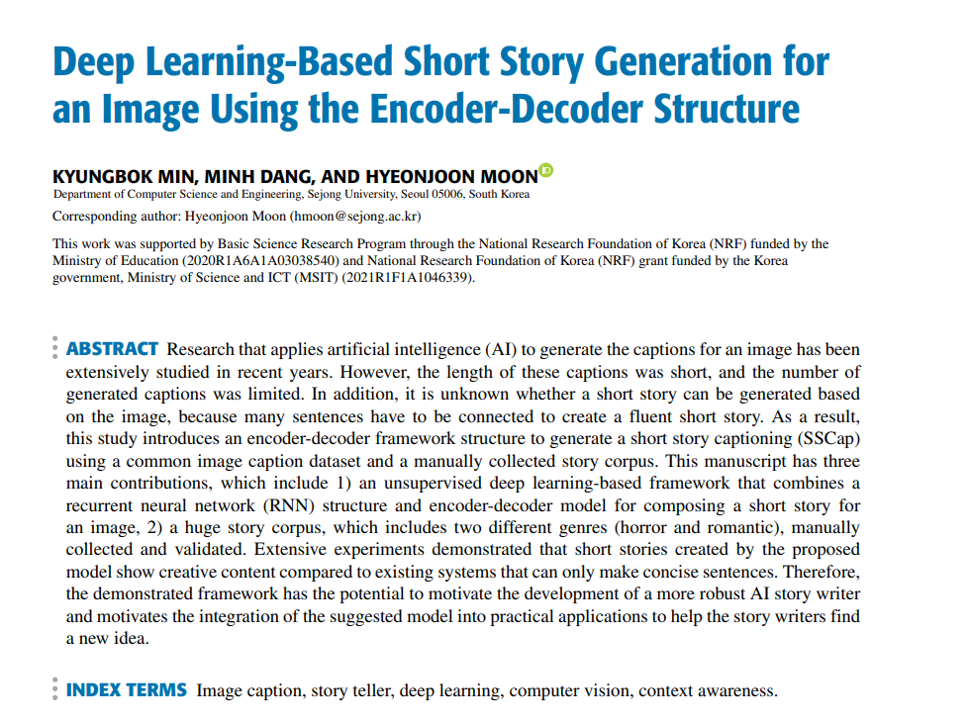

Slide 3
Pros:
Diverse Datasets: Utilizes both a large-scale image-caption dataset and a curated book dataset, enhancing model robustness.
Advanced Neural Networks: Skip-thought encoder-decoder for coherent story generation.
Novel Style Transfer: Implements deep style transfer to convert captions into specific story genres (romance/horror).
Detailed Methodology: Thorough explanation of model architecture and training with validated results.
Realistic Story Generation: Produces vivid, semantically coherent stories that match image content.
Cons:
Complex and Resource-Intensive: The model’s architecture requires significant computational resources.
Limited Story Dataset: The relatively small book dataset may limit genre diversity and model generalization.
Data Dependency: Model performance is highly dependent on the quality and diversity of training data.
Lack of Evaluation Metrics: No quantitative metrics provided for evaluating story quality.

Slide 4
Literature Review (11 Papers)
Paper | Year of Publication | Pros | Cons
Towards controllable story generation Authors: N. Peng, M. Ghazvininejad, J. May, K. Knight | 2018 | Introduces methods for controlling narrative flow in story generation, making AI-generated stories more coherent. Utilizes advanced natural language processing techniques for enhanced storytelling. | Limited by the complexity of integrating diverse narrative elements. May produce repetitive or formulaic content without further refinement.
Image captioning with deep bidirectional LSTMs and multi-task learning Authors: C. Wang, H. Yang, C. Meinel | 2021 | Enhances image captioning by incorporating bidirectional LSTMs and multi-task learning. Improves the contextual understanding of images, resulting in more accurate and relevant captions. | The model can be computationally intensive, affecting scalability. Performance may degrade with complex or cluttered images.

Slide 5
Paper | Year of Publication | Pros | Cons
Image-Based Storytelling Using Deep Learning YULIN ZHU Auckland University of Technology, Auckland 1010, New Zealand WEI QI YAN | 2020 | High Model Accuracy: The model achieved a high accuracy rate of 97.21% and 99.23% mean Average Precision (mAP), demonstrating its robustness and effectiveness in object detection and story generation | -Dependence on Templates: The storytelling approach heavily relies on pre-set templates, -Limited Impact of Transformers: While the paper explores the integration of Transformers in the model, the results indicate that this addition did not significantly improve performance due to the small sample size
Storytelling with Image Data: A Systematic Review and Comparative Analysis of Methods and Tools | 2015 | review paper with multiple approaches comparative analysis of multiple methods and algorithms | - Mainly focused on descriptive captions. - Less emphasis on generating complex storylines.
Deep visual-semantic alignments for generating image descriptions Authors: A. Karpathy, L. Fei-Fei | 2015 | Introduces an alignment model that maps images and their descriptions into a common feature space, improving caption quality. Provides a strong baseline for subsequent image captioning models. | The approach may struggle with generating highly descriptive or creative captions. Limited in handling images with multiple objects or complex scenes.
. Mind’s eye: A recurrent visual representation for image caption generation Authors: X. Chen, C. L. Zitnick | 2015 | Proposes a recurrent visual representation to enhance the temporal coherence of generated captions. Improves the alignment between visual and textual sequences, leading to more natural captions. | The model may be prone to generating overly simplistic captions. Requires extensive training data to achieve high performance.

Slide 6
Paper | Year of Publication | Pros | Cons
Image captioning with semantic attention Authors: Q. You, H. Jin, Z. Wang, C. Fang, J. Luo | 2016 | Introduces semantic attention, enabling the model to focus on meaningful parts of the image while generating captions, leading to more relevant and contextually accurate descriptions. | The model's complexity can lead to longer training times. May require fine-tuning to handle diverse image datasets effectively.
Automatic description generation from images: A survey of models, datasets, and evaluation measures Authors: R. Bernardi, R. Cakici, D. Elliott, A. Erdem, E. Erdem, N. Ikizler-Cinbis, F. Keller, A. Muscat, B. Plank | 2016 | Comprehensive survey covering various models, datasets, and evaluation metrics in image captioning. Provides valuable insights into the evolution of image captioning models and challenges in the field. | As a survey paper, it does not introduce new methods or models. The field has advanced rapidly since 2016, so newer developments may not be covered.
Microsoft COCO captions: Data collection and evaluation server Authors: X. Chen, H. Fang, T.-Y. Lin, R. Vedantam, S. Gupta, P. Dollar, C. L. Zitnick | 2023 | Introduces the Microsoft COCO dataset, a large-scale dataset crucial for advancing image captioning research. Provides standardized evaluation metrics, enabling consistent benchmarking of image captioning models. | Dataset biases can influence model performance. Evaluation metrics may not fully capture the nuances of generated captions.
Im2text: Describing images using 1 million captioned photographs Authors: V. Ordonez, G. Kulkarni, T. L. Berg | 2011 | Early work that leveraged a large dataset of captioned photographs to train image captioning models, paving the way for future research. Demonstrates the potential of using large datasets to improve captioning quality. | The model may struggle with generalization to unseen images. Limited by the quality and diversity of the dataset, which can impact the generated captions.

Slide 7
Novelty
1. Introduction of Multiple Genres
Expand the system to handle and generate stories in multiple genres beyond horror and romance, such as:
Science Fiction
Fantasy
Mystery
Comedy
Drama
2. Use of Advanced Transformative Models
Replace the RNN-based encoder-decoder architecture with a more advanced transformative model, such as:
Transformers (e.g., GPT-4, BERT)
Hybrid models combining CNNs with Transformers for better contextual understanding.

Slide 8
Novelty
3. Multi-Image Input Handling
Enable the system to generate a cohesive short story based on multiple images, processing them sequentially or simultaneously.
4. Video Story Generation
Extend the model to handle video inputs by:
Sampling frames from the video at specific time intervals.
Generating a narrative that captures the temporal progression and visual content of the video.

Slide 9
Dataset
2. Conceptual Captions Dataset(MSCOCO-2017)
Description: The Conceptual Captions dataset is a large-scale dataset containing over 3.3 million image-caption pairs. It was created by Google using a web-scale, automatically collected approach. The captions were filtered and extracted from various online sources, offering a broad variety of images and textual descriptions. This dataset is larger than the popular MS-COCO dataset and is more diverse in terms of image-caption pairings.
Usage in the Paper: This dataset was used to train the image captioning model, which generates captions that serve as the basis for the story generation process. The captions describe the visual content of the images, which are then transformed into short stories.
Link to Conceptual Captions Dataset: Conceptual Captions Dataset (Google)

Slide 10
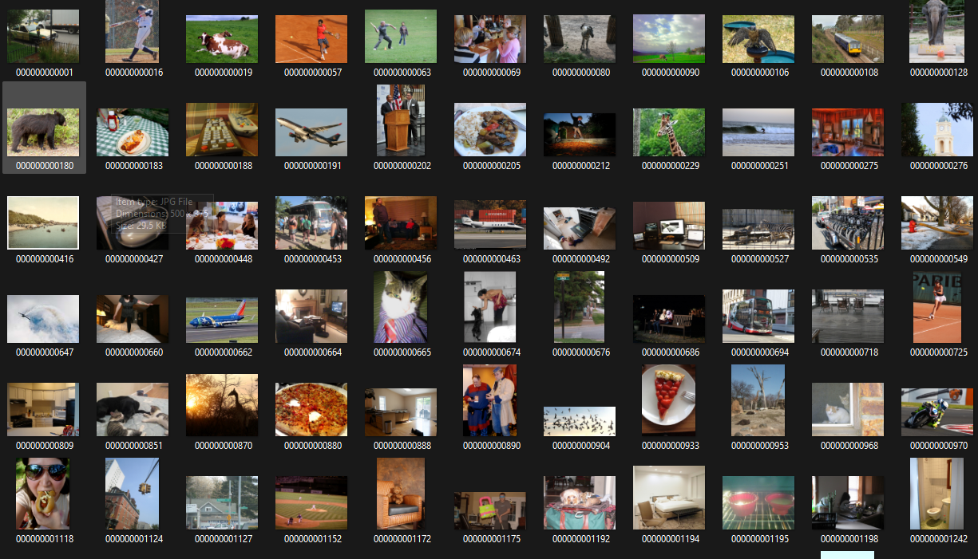
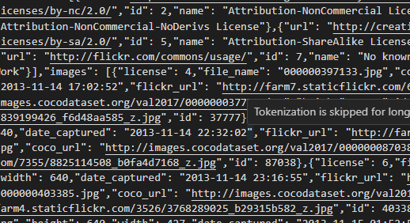
Dataset
Annotations
Images

Slide 11
Innovations
Our project combines video-based caption generation with localized story generation to create cohesive narratives. By leveraging a CNN-based image captioning model and a locally run LLM (Llama 3.1), we are able to capture sequential frames from a video, synthesize captions, and generate coherent, theme-driven stories. This approach introduces a novel application of multiple-caption aggregation, providing a richer context than single-frame captioning models. Additionally, the local deployment of the LLM ensures privacy and control over the generative process.

Slide 12
Research Objectives
To generate coherent, meaningful stories by combining frame-level captions with a theme-driven prompt.
To evaluate the quality and thematic alignment of generated stories against actual human narratives using DLU E and ROUGE scores.
To establish a proof of concept for frame-by-frame captioning combined with LLM story generation, adding depth to video-based content interpretation

Slide 13
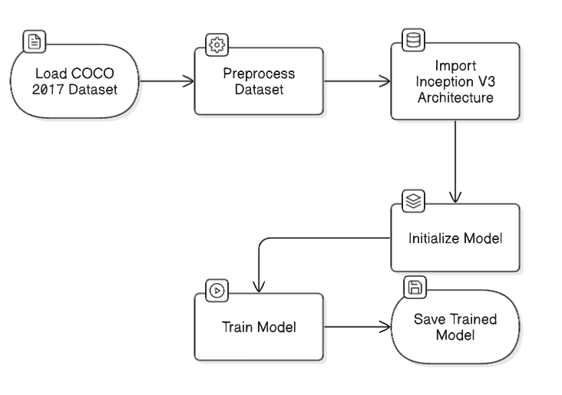
Methodology

Slide 14
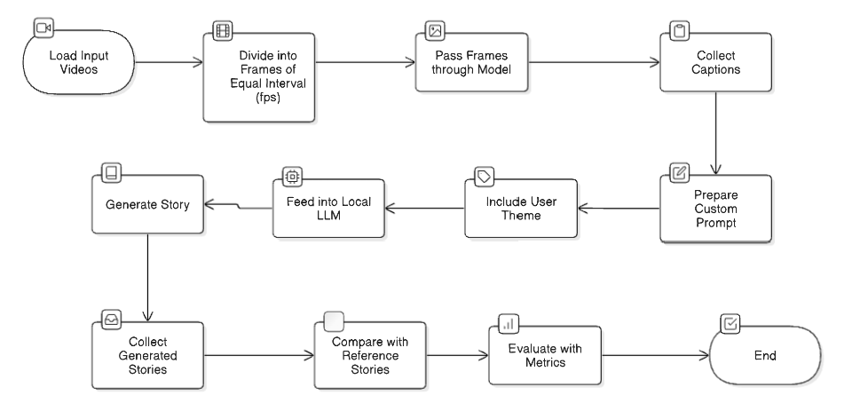
Methodology

Slide 15
Methodology (System Architecture and Data Flow)
Our system follows a structured pipeline:
Input Video: The video is inputted and divided into frames at specific intervals.
Caption Generation: Each frame is captioned using a pretrained CNN encoder-decoder model (Inception V3), leveraging the COCO 2017 dataset for training.
Caption Aggregation: The individual captions are compiled, creating a storyline input that captures the essence of the video.
Story Generation with LLM: A custom prompt, including aggregated captions and thematic cues, is fed to the LLM to generate a coherent story.
Output Story: The generated story reflects the narrative inferred from the video.

Slide 16
Methodology (System Architecture and Data Flow)
System Components:
CNN Encoder-Decoder (Inception V3): Trained on COCO 2017, this model is designed for efficient captioning of frames with minimal fine-tuning.
Local LLM (Llama 3.1): Generates the final story based on thematic cues.
Evaluation Metrics: We use DLU E and ROUGE scores to compare the generated story with reference text, ensuring quality and thematic accuracy.

Slide 17
Methodology (System Architecture – Layered Approach)
Layer 1: Input Layer – Video Preprocessing
The process begins by taking a video as input. This video is divided into frames at predefined intervals, capturing key moments that represent the essence of the video.
Layer 2: Feature Extraction Layer – CNN Encoder (Inception V3)
Each frame is fed into a CNN encoder (Inception V3 architecture), which extracts visual features from the images.
This pretrained model, fine-tuned on the COCO 2017 dataset, ensures that each frame’s content is captured with minimal additional training.
Layer 3: Captioning Layer – Decoder and Caption Generation
Visual features extracted from each frame are passed through a decoder, which generates captions.
The model uses the encoder-decoder structure to create textual descriptions for each frame, resulting in a sequence of captions that represent the video.

Slide 18
Methodology (System Architecture – Layered Approach)
Layer 4: Aggregation and Prompt Creation Layer
The generated captions are aggregated sequentially to form a base narrative.
A custom prompt is then crafted by combining the aggregated captions with thematic words to guide the story generation model.
Layer 5: Story Generation Layer – Local LLM (Llama 3.1)
The custom prompt, now containing aggregated captions and thematic instructions, is fed into the local LLM (Llama 3.1).
This layer generates a cohesive story based on the given prompt, creating a narrative that reflects the video's theme.
Layer 6: Evaluation Layer
The generated story is compared to the original narrative using DLU E and ROUGE scores.
These metrics evaluate the quality of the story in terms of thematic alignment, coherence, and similarity to human narratives, providing quantitative insights into the model’s performance.

Slide 19
Implementation/Proof of Concept
Captioning Pipeline:
The caption generation process uses a CNN encoder-decoder architecture with Inception V3, pretrained on COCO 2017, which contains extensive labeled data. With its pretrained weights, minimal fine-tuning (just a few epochs) was required, significantly optimizing training time. This model is then applied to frames extracted at regular intervals, ensuring that each frame contributes contextually to the final story.
Story Generation:
For story generation, the LLM (Llama 3.1) is provided with a custom prompt built from the concatenated captions and thematic keywords. The LLM, running locally, combines these captions to create a narrative consistent with the desired story theme. This localized LLM setup maintains the privacy and control of our generated data.

Slide 20
Implementation/Proof of Concept
Pipeline Setup:
Frames are extracted at specified intervals to capture the essence of each video. Captions are generated for each frame, compiled, and structured into a single prompt. The LLM then processes the prompt, outputting a cohesive story based on the video's content.

Slide 21

Results and Analysis :
Sample video:

Slide 22
We evaluated the model using a set of 60-second positive story videos sourced from a dedicated YouTube channel that specializes in short, uplifting stories. This dataset allows for a consistent comparison between human-generated and machine-generated narratives.
Comparison Metrics:
To assess story quality, we use DLU E and ROUGE scores, which provide an objective measure of thematic and linguistic alignment between the generated story and the reference narrative (transcript and video description). These metrics quantify the similarity of word sequences, capturing how well the generated story reflects the original narrative.

Slide 23
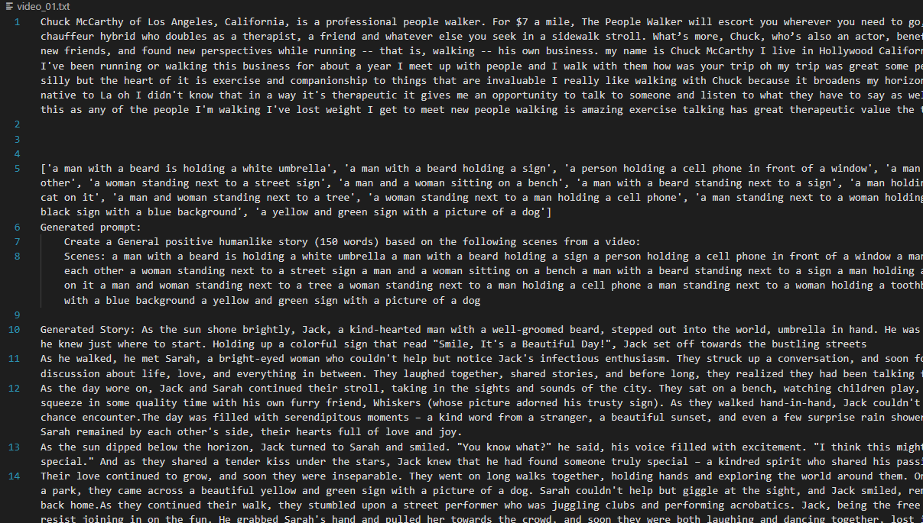
Results and Analysis :

Slide 24
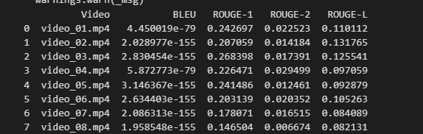
Results and Analysis :

Slide 25
Results and Analysis :
BLEU Scores: Very low across all videos, indicating limited exact word overlap with reference stories, likely due to the creative flexibility of storytelling.
ROUGE-1 Scores: Moderate overlap in key words, with scores ranging from 0.14 to 0.27. Video 03 achieved the highest alignment with the reference story.
ROUGE-2 Scores: Low bigram (two-word sequence) overlap, suggesting diverse phrasing and limited sequence similarity.
ROUGE-L Scores: Moderate structural alignment, especially in Video 02, indicating that some generated stories retain a structural flow similar to the reference.
Overall Performance:
Best alignment with reference text observed in Video 03.
Lowest alignment in Video 08, possibly due to challenges in capturing specific narrative themes.
Key Insight: The model generates creative and thematically consistent stories, though exact word and phrase matching with references remain limited.

Slide 26
Outcome:
Our results indicate strong thematic alignment in most cases, with generated stories effectively reflecting key aspects of the videos. However, challenges remain in maintaining coherence across multiple captions when scenes change rapidly. Overall, our proof of concept demonstrates the potential of combining frame-level captioning with story generation, offering a novel approach to automatic video interpretation.

Slide 27
Thank You

